Slide 1
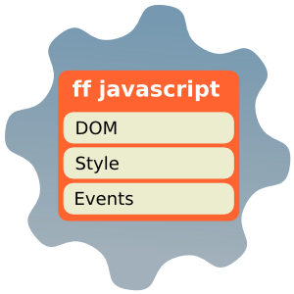


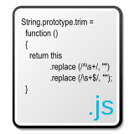
JavaScript Event Model
Create a usable interface
Telerik Software Academy
Learning & Development Team
http://academy.telerik.com

Slide 2
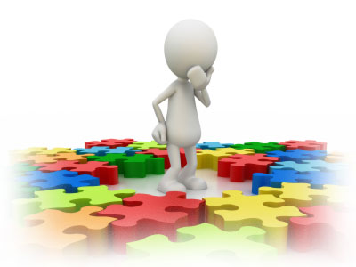
Table of Contents
JavaScript Event Model
Event Registration
HTML Attributes, DOM Properties and Methods
Event Object
Cross-Browser Event Handler
Capturing and Bubbling Events
Custom Events

Slide 3

JavaScript Event Model

Slide 4
Event Model
The DOM event model provides a way for the user to interact with the browser environment
The DOM event model consists of events and event listeners attached to the DOM objects
<button>Click me</button>
On Click Listener
DOM Element
Event Listener

Slide 5
Event Types
DOM provides a set of common event types that are used in 99% of the time
Mouse events
Touch events
Form events
Keyboard events
DOM events
Full list of all DOM event types:
http://www.w3.org/TR/DOM-Level-3-Events/#event-types-list
You could also defined Custom Event Types

Slide 6
Common Event Types
Mouse Events
click
hover
mouseup
mousedown
mouseover
mouseout
Keyboard Events
keydown
keypress
keyup

Slide 7
Common Event Types (2)
UI Events
load
abort
select
resize
change
Focus Events
blur
focus
focusin
focusout

Slide 8
Common Event Types (3)
Touch Events
touchstart
touchend
touchcancel
touchleave
touchmove
No event for tap: use click

Slide 9
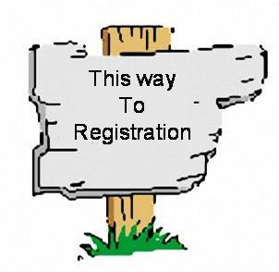
Event Registration

Slide 10
Event Handlers
The developer could register an event handler/listener for a specific event type and DOM element
The registration can be performed with:
HTML Attributes
Using DOM element properties
Using DOM event handler

Slide 11
As HTML Attibute
Event handlers can be attached by simply setting a value to the handler attribute
This value is pure JavaScript and is not always a function
<button>Click Me</button>
<button onclick="buttonClickFunction()">Click Me</button>
function buttonClickFunction() {
console.log("You click the Button");
}

Slide 12
Register Event Handlers using HTML Attributes
Live Demo

Slide 13
Using DOM Element Properties
Use standard DOM events on certain DOM element and assign a reference to a function
Can be anonymous
<button id="click-button">Click me</button>
var button = document.getElementById("click-button");
button.onclick = function onButtonClick() {
console.log("You clicked the button");
}

Slide 14
Using DOM Element Properties
Live Demo

Slide 15
Using DOM
The standard way for attaching event handlers to DOM
The Basic Syntax is:
Example:
domElement.addEventListener(eventType,
eventHandler,
isCaptureEvent)
var button = document.getElementById("click-button");
button.addEventListener("click", function () {
console.log("You clicked me");
}, false);

Slide 16
Registering Event Handlers Using DOM
Live Demo

Slide 17

The Event Object
Get the Event data

Slide 18
Event Object
The event handlers have access to the event object passed as function parameter
The event object contains information about:
The type of the event
The target of the event
The key that was pressed when a keyboard event was fired
The mouse button that was pressed when a mouse event was fired
The position of the mouse on the screen

Slide 19
Event Object (2)
The event object is accessible as the only argument of the function handler
function onButtonClick(event) {
console.log(event.target);
console.log(event.type);
console.log("(" + event.clientX + ", " + event.clientY + ")");
}
button.addEventListener("click", onButtonClick, false);
Yet, there is IE - it does not pass event object
Keeps the event object in window.event
Fortunately there is a simple fix
function onButtonClick(event) {
if(!event) event = window.event;
// Your code…
}

Slide 20

Event Object
Live Demo

Slide 21
Cross-Browser Event Handler
Remember a certain browser?

Slide 22
Cross-browser Compatibility
addEventListener is n0t supported everywhere
Older versions of IE have their own method to attach event handlers
attachEvent("on" + eventType, handler)
domElement.attachEvent("on" + eventType, eventHander);
Use feature detection:
// Up to IE8
if (document.attachEvent){
domElement.attachEvent(…);}
// IE 9, IE 10, Firefox, Chrome, Opera, Safari
else if (document.addEventListener) {
domElement.addEventListener(…); }
// Reeeally old browsers
else { domElement["on" + eventType] = handler; }

Slide 23

CrossBrowser Event Handler
This can be wrapped in a method:
Create a function with three parameters
Target element
Event type
Event handler
Use the method your browser supports

Slide 24
Cross-Browser Event Handler
Live Demo

Slide 25
Capturing and Bubbling Events
Top to Bottom and the other way around

Slide 26
Event Chain
When the user clicks on an HTML element, the event is also fired on all of its parents
Fired
<html>
<body>
<div>
<button>
Click Me
</button>
</div>
</body>
</html>
Fired
Fired
Fired
Click
The button is still the target, but the click event is fired on all of its parents
An event is fired on all elements in the chain

Slide 27
Event Chain
Live Demo

Slide 28
Two Types of Event Chains
There are two types of event chains
Capturing and Bubbling
Bubbling handlers bubble up to the parent
The first executed handler is on the target
Then its parent's, and its parent's, etc…
Capturing handlers go down the chain
The first executed handler is on the parent of all
The last executed handler is on the target

Slide 29
Capturing
Capturing goes down the event chain
The first executed handler is the one of the parent of all
1
HTML
2
BODY
3
DIV
4
BUTTON
User clicks the Button

Slide 30
Bubbling
Bubbling bubbles up the event chain
The first executed handler is the one on the target
4
HTML
3
BODY
2
DIV
1
BUTTON
User clicks the Button

Slide 31
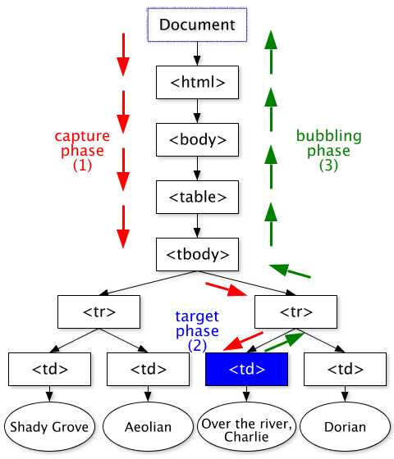
Capturing and Bubbling
Live Demo

Slide 32
Custom Events

Slide 33
CustomEvent
To create custom events use the CustomEvent() constructor
Example:
Create custom event tripleclick
Get body element to attach custom event to and addEventListener
var event = new CustomEvent(eventType);
var event = new CustomEvent("tripleClick");
var body = document.getElementsByTagName("body")[0];
body.addEventListener("tripleClick", function() {
alert("You click three times");
}, false);

Slide 34
Custom Events (2)
To trigger the custom event use:
Example
body.dispatchEvent(event);
(function() {
var button = document.getElementById("btn-click");
var counter = 0;
button.addEventListener("click", function() {
counter++;
if(counter == 3) {
body.dispatchEvent(event); // Fire the event
}
}, false)
}());

Slide 35

Custom Events
Live Demo

Slide 36
JavaScript Event Model
http://academy.telerik.com

Slide 37
Homework
Create a TODO list with the following UI controls
Form input for new Item
Button for adding the new Item
Button for deleting some item
Show and Hide Button

